Slide 1



|| Jai Sri Gurudev ||
BGSKH Education Trust (R.) – A unit of Sri Adichunchanagiri Shikshana Trust(R.)
BGS College of Engineering and Technology (BGSCET)
Mahalakshmi puram, West of Chord Road, Bengaluru-560086
Mini Project(BCG586)
Presentation on
Title : SMS Spam Detection Using Explainable AI
Team Members with USN Guide Name
1. Niranjan K (1MP23CG043) Mrs.Sanjitha S
2. Saniya BK (1MP23CG051) Asst-Professor
3. Shamya MG (1MP23CG053)
4. Yashwanth Kumar S (1MP23CG063)
Project Coordinator HOD
Mrs.Sanjitha S Dr.Madhu Patil

Slide 2







CONTENTS
INTRODUCTION
SYSTEM REQUIREMENT
PROPOSED METHODOLOGY
OBJECTIVES
LITERATURE SURVEY
REFERENCES

Slide 3


INTRODUCTION
Rapid growth of mobile communication has led to an increase in unsolicited/spam SMS.
Spam messages can be harmful (phishing, scams, promotions).
AI and Machine Learning provide intelligent solutions to classify SMS as spam or ham (non-spam).
Goal: To build a system that detects and filters spam messages efficiently.

Slide 4


OBJECTIVES
To develop an AI-based model for SMS spam detection.
To preprocess SMS data (stemming, tokenization, stop-word removal).
To train ML algorithms (Naive Bayes) on labeled SMS dataset using TF-IDF features.
Develop a real-time Streamlit web app to predict spam or ham.
To evaluate performance using accuracy, precision, recall, and F1-score.
To provide a user friendly interface and reliable system that reduces spam messages reaching users.

Slide 5


SYSTEM REQUIREMENT
Software Requirement
Language : Python
Framework : Streamlit
Dependencies : Python, Pandas, NumPy, scikit-learn, nltk.
Dataset : SMS Spam Collection Dataset
Environment : VS code/ PyCharm
Hardware Requirement
Processor : Intel i3/i5 or higher
RAM : 4 GB minimum
Storage : 500 MB – 1 GB for dataset and model

Slide 6


LITERATURE SURVEY
Sl.no | Title | Author | Year | Algorithms Used | Data Used | Limitation
1 | Human Induced Bias in SMS Spam | Gerard Shu Fuhnwi & Matthew Revelle | 2025 | Logistic Regression, XG Boost | SMS Spam collection Dataset | Dataset Limited to English Messages Only
2 | Arabic SMS Spam Detection | Ali Ailzubaidi & Sakher Ghanem | 2025 | Naïve Bayes, Support Vector Machine(SVM) | 565 Arabic SMS Messages | Small dataset size
3 | AI Driven Smishing Detection in Android Device | Akshat Gaurav & Brij B Gupta | 2025 | TinyBERT, Aquila Optimization | SMS Spam collection Dataset | Model showed Lower recall for spam(82%)

Slide 7
Sl.no | Title | Author | Year | Algorithms Used | Data Used | Limitation
4 | Indian SMS Spam using Machine Learnig Techinques | S.Ratan Kumar & D.V.Naga Raju | 2024 | Support Vector Machine(SVM), K-Nearest Neighbors (KNN) | Indian SMS Spam Dataset | Limited Dataset size
5 | Enhancing security in SMS for Spam Detection | Aditya Kumar & Fancy C | 2023 | Naive Bayes, Support Vector Machine(SVM) | UCI Machine Learning Repository | Steganography Limited to 1-bit LSB Technique

Slide 8


ARCHITECTURE
SPAM
DATA COLLECTION
PRE
PROCESSING
FEATURE
EXTRACTION
MODEL
TRAINING
NOT SPAM
Fig. SMS Spam Detection Working Model

Slide 9







PROPOSED METHODOLOGY
Data Collection: Using publicly available SMS Spam datasets
Preprocessing: Removing punctuation, converting to lowercase, tokenization, stop-word removal, stemming.
Feature Extraction: TF-IDF Vectorization.
Model Training: Using algorithms like Naive Bayes classifier.
Evaluation: Measure accuracy, precision, recall, and F1-score

Slide 10


IMPLEMENTATION
Preprocessing: Cleaned SMS text by removing URLs, punctuation, stopwords, and converting to lowercase.
Tokenization: Split each message into individual words.
Term Frequency (TF): Calculated how often each word appears in a message.
Inverse Document Frequency (IDF): Reduced the weight of common words and increased the weight of rare, informative words.
Vectorization: Converted messages into numerical TF-IDF vectors (unigrams + bigrams).
Output: Produced feature vectors that highlight important spam-indicative keywords for model training.

Slide 11
Model Selection: Used Multinomial Naïve Bayes, ideal for text data represented as frequency/TF-IDF vectors.
Training: Fed TF-IDF vectors into the Naïve Bayes classifier using an 80/20 train-test split.
Probability Calculation: Model computes the likelihood of a message being Spam or Ham using Bayes’ theorem.
Prediction: For each new SMS, the classifier outputs the category with the highest probability.
Evaluation: Assessed performance using accuracy, precision, recall, F1-score, and confusion matrix.
Strength: Fast, efficient, and highly effective for spam detection tasks.

Slide 12


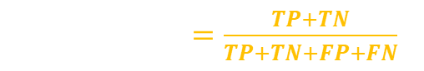
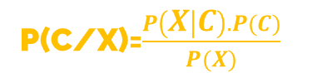
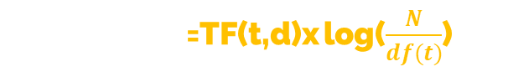
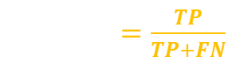

PERFORMANCE EVALUATION METRIC
TP (True Positive)
TN (True Negative)
FP (False Positive)
FN (False Negative)
TF-IDF(t,d)=TF(t,d)x log($\frac{N}{df(t)}$)
Accuracay$=\frac{TP+TN}{TP+TN+FP+FN}$
Precision$=\frac{TP}{TP+FP}$
TF(t,d) = Term Frequency
N = Total Documents
Df(t) = Documents containing the term
Recall$=\frac{TP}{TP+FN}$
TP : Spam correctly classified as spam.
TN : Not spam correctly classified as not spam.
FP : Not spam wrongly classified as spam.
FN : Spam wrongly classified as not spam.
F1 - Score$=2 ∗ \frac{Precision∗Recall}{Precision+Recall}$
Navie Bayes =
P(C/X)=$\frac{P\left(X | C\right).P(C)}{P(X)}$
C : Class
X : Message

Slide 13

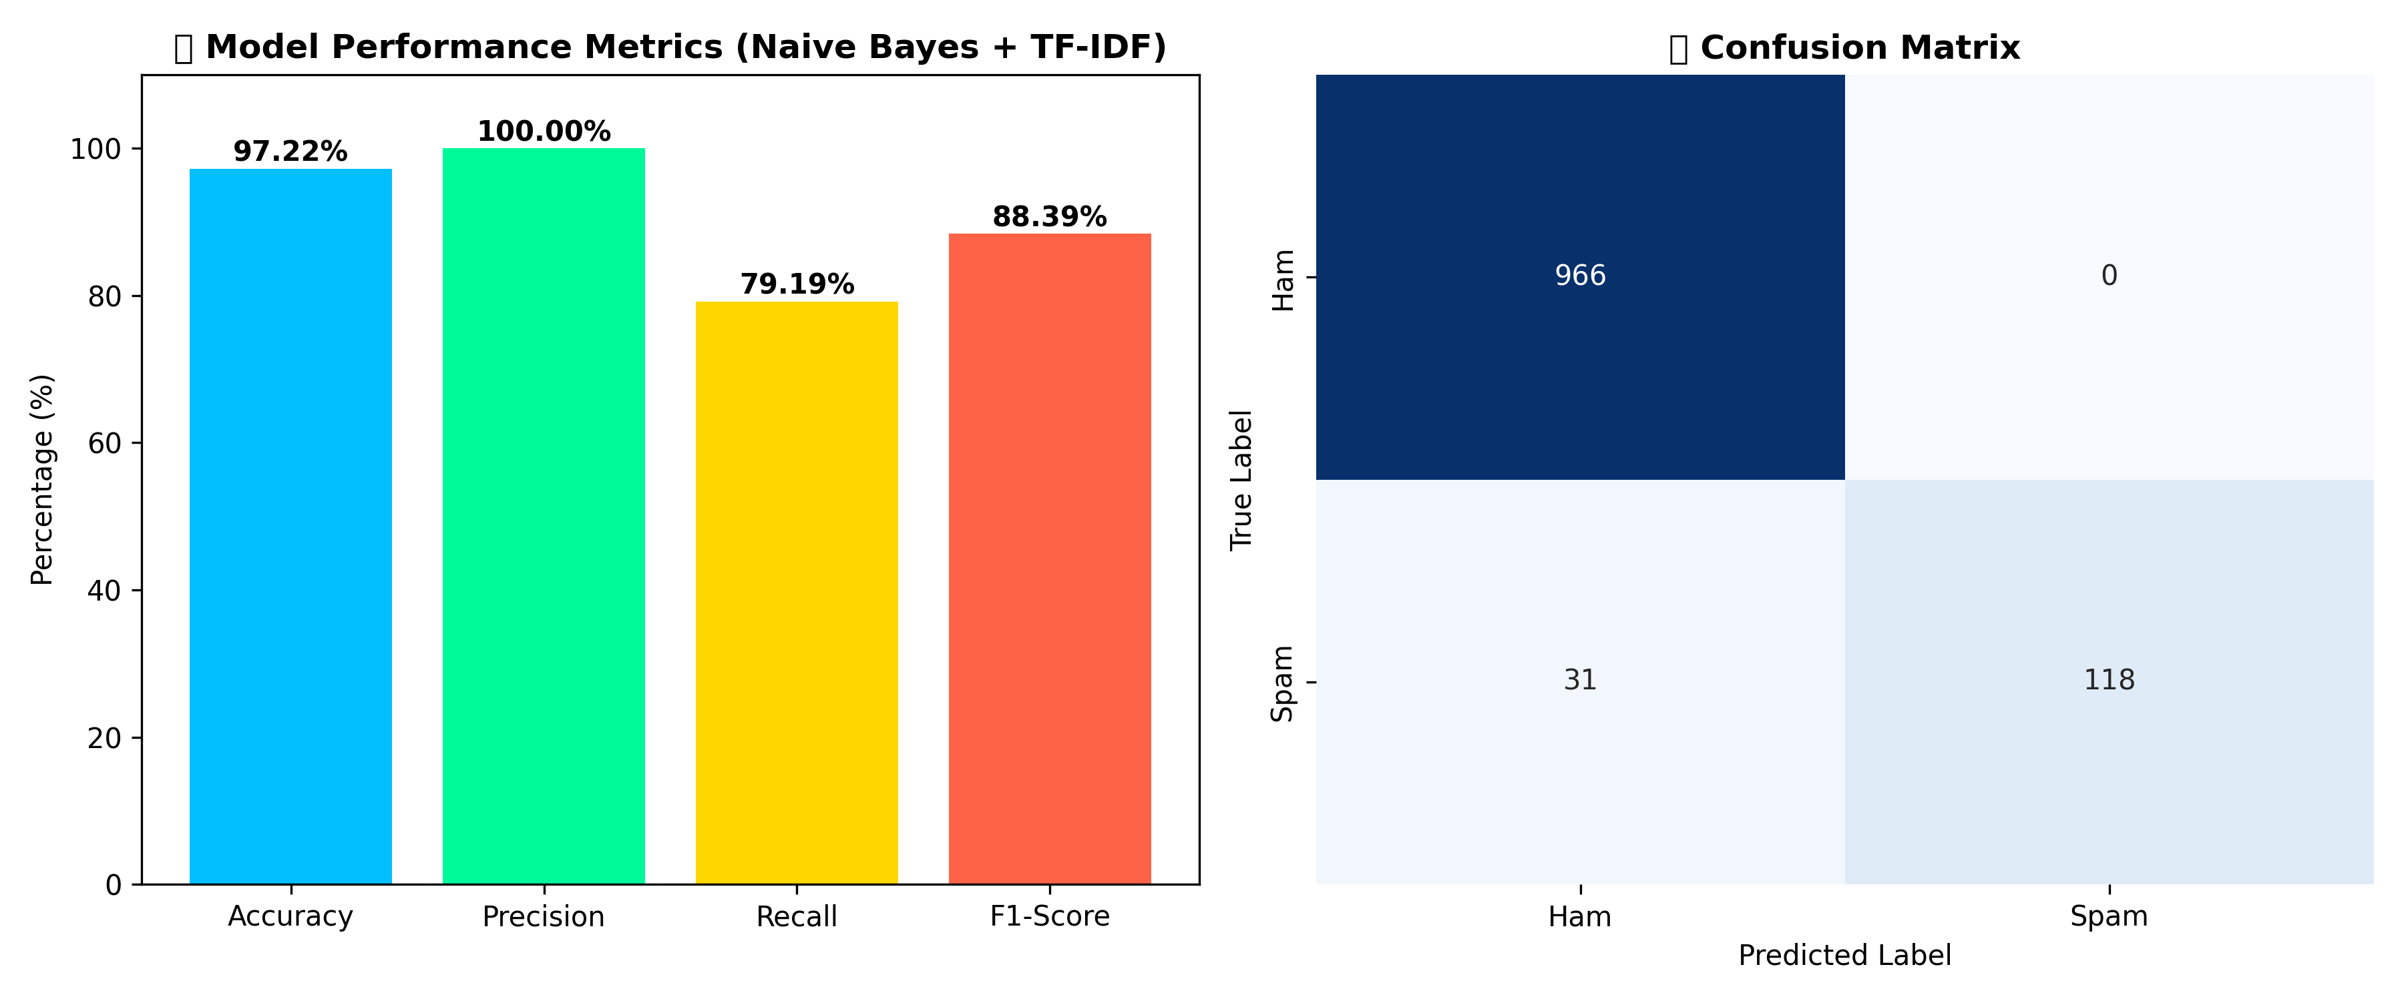
RESULT

Slide 14
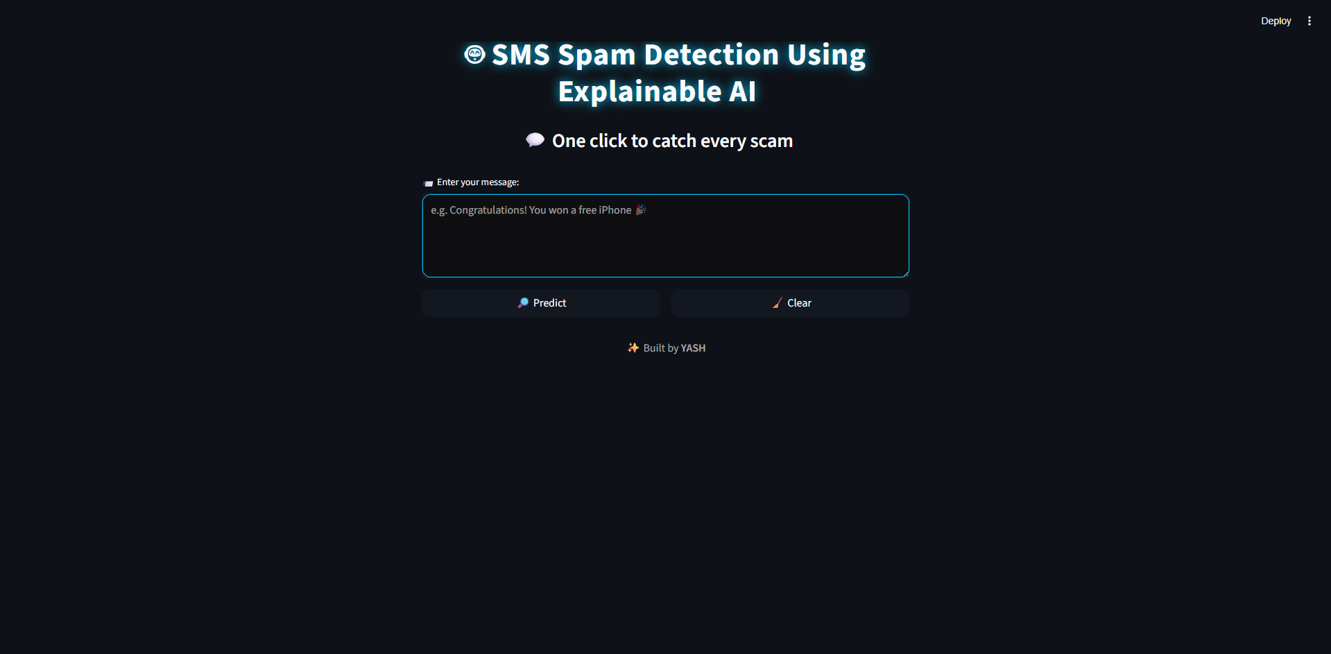
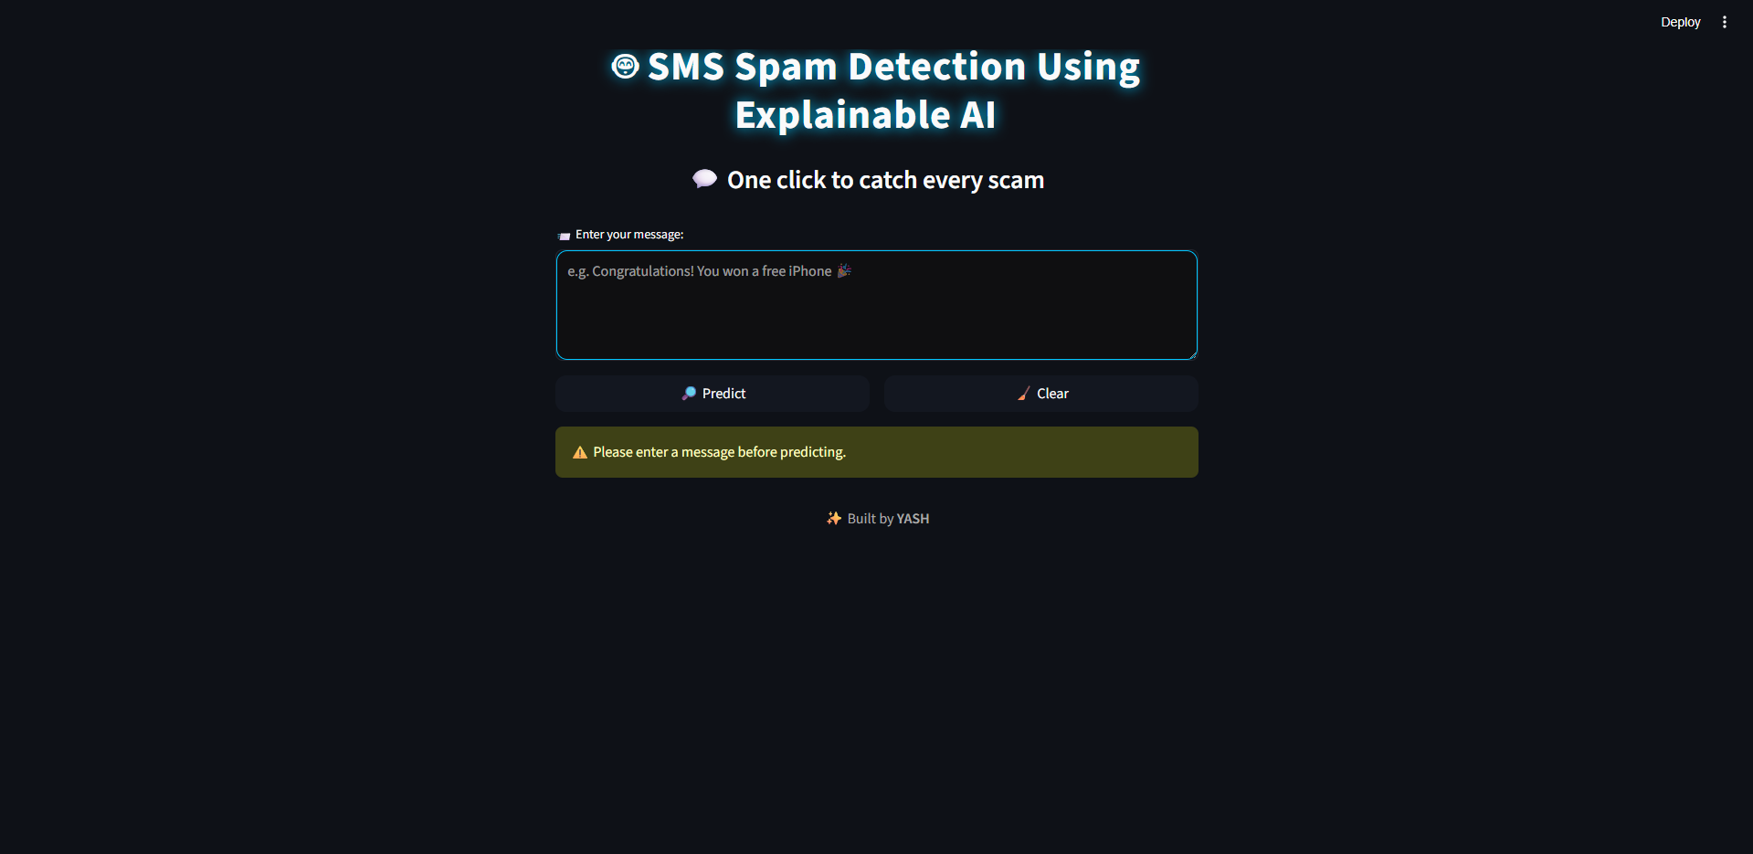
RESULT

Slide 15
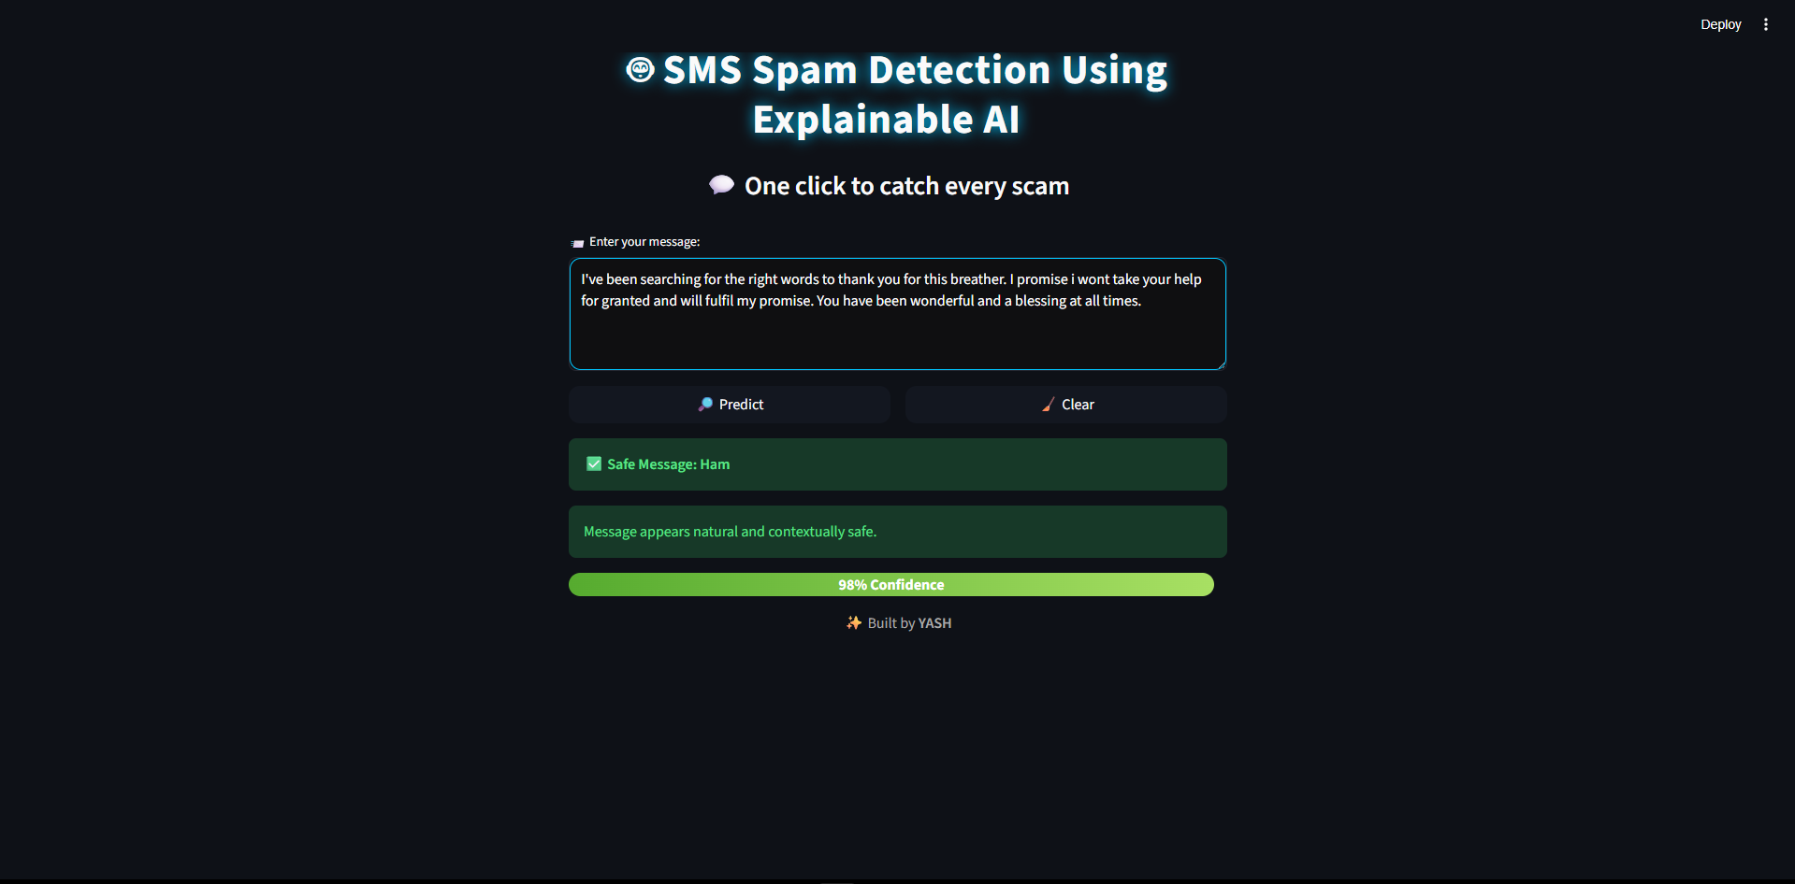
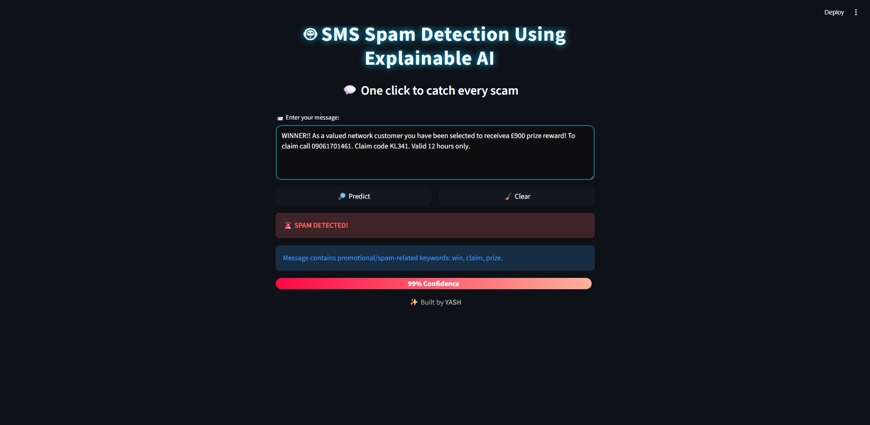

Slide 16


FUTURE SCOPE
Integration with real-time SMS, WhatsApp, and email platforms.
Support for multilingual spam detection (English + regional languages).
Mobile app/API integration for telecom operators and businesses.
Extension to other platforms such as email, WhatsApp, and social media chats.
Explainable AI improvements with keyword highlighting for spam indicators.

Slide 17


REFERENCES
Gerard Shu Fuhnwi et al. “Using Large Language Models to Mitigate Human-Induced Bias in SMS Spam: An Empirical Approach”, 2025
Ali Ailzubaidi et al. “Arabic SMS Spam Detection” , 2025
Akshat Gaurav et al. “AI –Driven Smishing Detection in Andoid Devices Using TinyBERT and Aquila Optimization” , 2025
S.Ratan Kumar et al. “BERT-Driven Feature Extraction for Classifying Indian Spam SMS Using Machin Learning Techniques” , 2024
Aditya Kumar et al. “Enhancing Security In SMS By Combining NLP Models Using Ensemble Learning For Spam Detection Using Image Steganography Integration”, 2023

Slide 18


